Slide 1


Calculus and applications
MTH10012
Week 11

Slide 2
Introduction
Week 10
First order linear DE: integrating factors; application of first order ODEs.
Second order ODEs with constant coefficients
General solution for the homogeneous and inhomogeneous cases
Week 11
Method of undetermined coefficients to find a particular solution to the inhomogeneous case of a second order ODE with constant coefficients.
Initial value problems for second order ODEs with constant coefficients.
Applications of second order linear ODEs.
Functions of two variables
The method of cross-sections and simple surfaces
MODULE 7

Slide 3
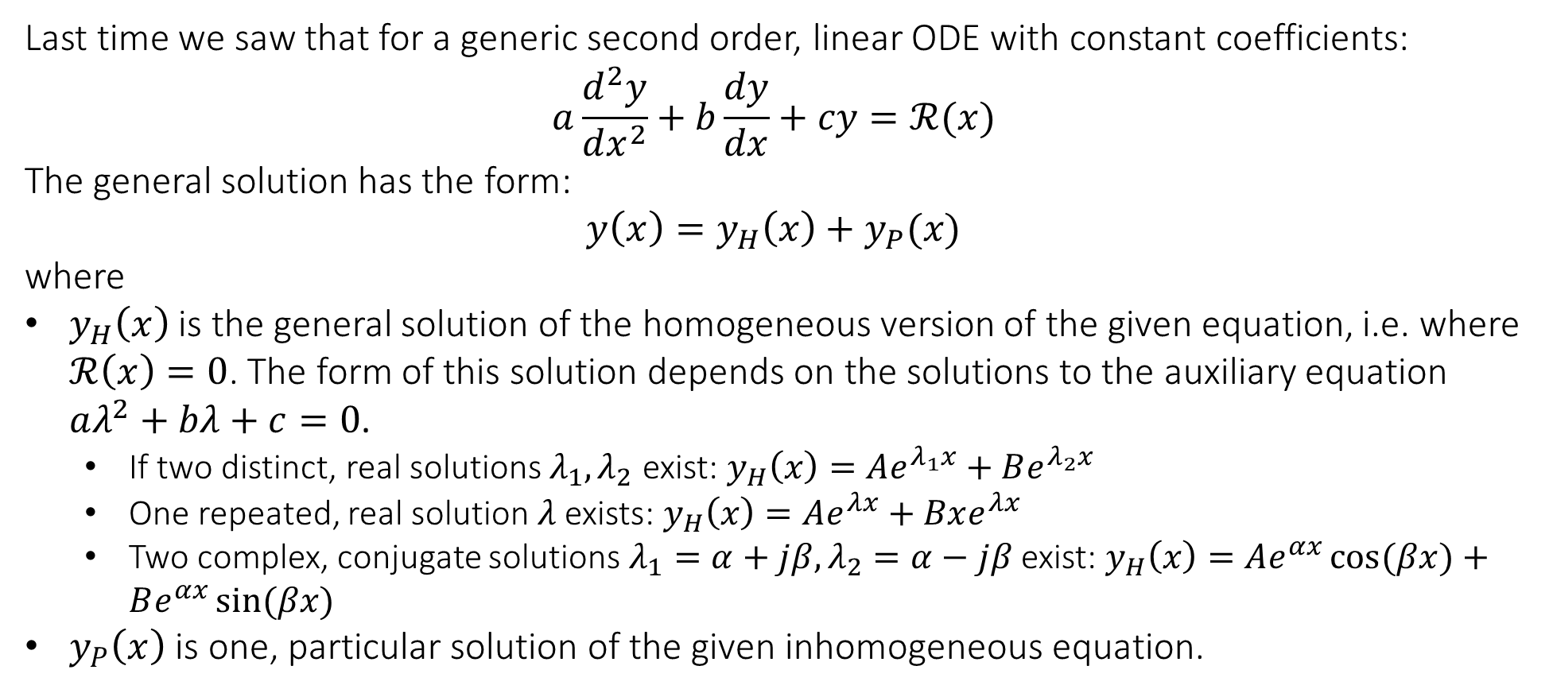
Recap
Last time we saw that for a generic second order, linear ODE with constant coefficients:
$$a\frac{d^{2}y}{dx^{2}}+b\frac{dy}{dx}+cy=ℛ(x)$$
The general solution has the form:
$$y\left(x\right)=y_{H}\left(x\right)+y_{P}(x)$$
where
$y_{H}\left(x\right)$ is the general solution of the homogeneous version of the given equation, i.e. where $ℛ\left(x\right)=0$. The form of this solution depends on the solutions to the auxiliary equation $aλ^{2}+bλ+c=0$.
  If two distinct, real solutions $λ_{1},λ_{2}$ exist: $y_{H}\left(x\right)=Ae^{λ_{1}x}+Be^{λ_{2}x}$
  One repeated, real solution $λ$ exists: $y_{H}\left(x\right)=Ae^{λx}+Bxe^{λx}$
  Two complex, conjugate solutions $λ_{1}=α+jβ,λ_{2}=α−jβ$ exist: $y_{H}\left(x\right)=Ae^{αx}\cos{(βx)}+Be^{αx}\sin{(βx)}$
$y_{P}\left(x\right)$ is one, particular solution of the given inhomogeneous equation.

Slide 4
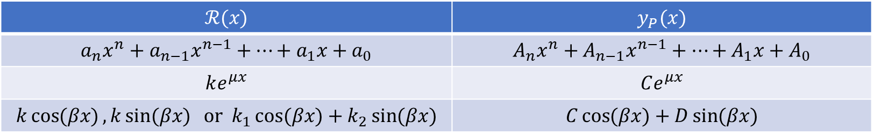
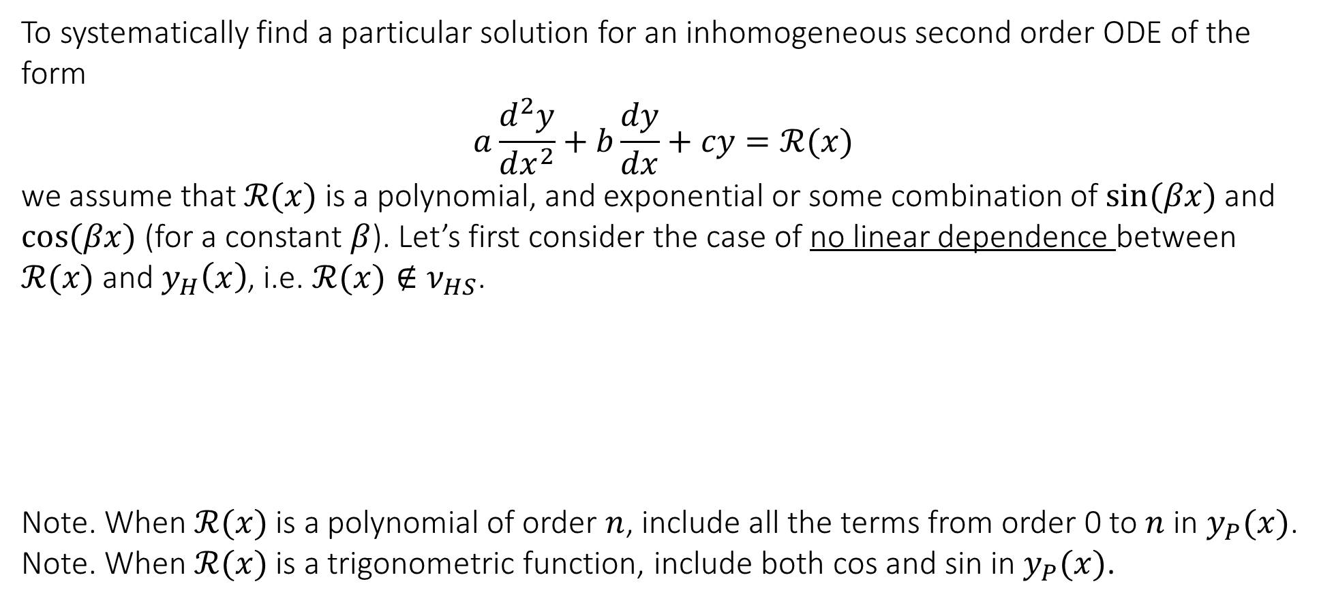
6.8 Finding a particular solution with the method of undetermined coefficients
To systematically find a particular solution for an inhomogeneous second order ODE of the form
$$a\frac{d^{2}y}{dx^{2}}+b\frac{dy}{dx}+cy=ℛ(x)$$
we assume that $ℛ(x)$ is a polynomial, and exponential or some combination of $\sin{(βx)}$ and $\cos{(βx)}$ (for a constant $β$). Let’s first consider the case of no linear dependence between $ℛ(x)$ and $y_{H}\left(x\right)$, i.e. $ℛ(x)∉ν_{HS}$.
Note. When $ℛ(x)$ is a polynomial of order $n$, include all the terms from order 0 to $n$ in $y_{P}(x)$.
Note. When $ℛ(x)$ is a trigonometric function, include both cos and sin in $y_{P}(x)$.
$$ℛ(x)$$ | $$y_{P}(x)$$
$$a_{n}x^{n}+a_{n−1}x^{n−1}+…+a_{1}x+a_{0}$$ | $$A_{n}x^{n}+A_{n−1}x^{n−1}+…+A_{1}x+A_{0}$$
$$ke^{μx}$$ | $$Ce^{μx}$$
$$k\cos{(βx)},k\sin{(βx)} or k_{1}\cos{(βx)}+k_{2}\sin{(βx)}$$ | $$C\cos{(βx)}+D\sin{(βx)}$$

Slide 5
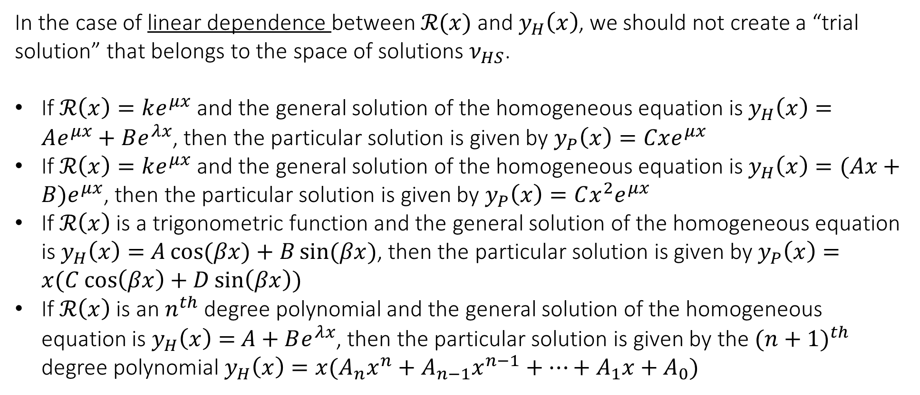
6.8 Finding a particular solution with the method of undetermined coefficients
In the case of linear dependence between $ℛ(x)$ and $y_{H}\left(x\right)$, we should not create a “trial solution” that belongs to the space of solutions $ν_{HS}$.
If $ℛ\left(x\right)=ke^{μx}$ and the general solution of the homogeneous equation is $y_{H}\left(x\right)=Ae^{μx}+Be^{λx}$, then the particular solution is given by $y_{P}\left(x\right)=Cxe^{μx}$
If $ℛ\left(x\right)=ke^{μx}$ and the general solution of the homogeneous equation is $y_{H}\left(x\right)=(Ax+B)e^{μx}$, then the particular solution is given by $y_{P}\left(x\right)=Cx^{2}e^{μx}$
If $ℛ\left(x\right)$ is a trigonometric function and the general solution of the homogeneous equation is $y_{H}\left(x\right)=$ $A\cos{(βx)}+B\sin{(βx)}$, then the particular solution is given by $y_{P}\left(x\right)=x(C\cos\left(βx\right)+D\sin\left(βx\right))$
If $ℛ\left(x\right)$ is an $n^{th}$ degree polynomial and the general solution of the homogeneous equation is $y_{H}\left(x\right)=$ $A+Be^{λx}$, then the particular solution is given by the ${(n+1)}^{th}$ degree polynomial $y_{H}\left(x\right)=x(A_{n}x^{n}+A_{n−1}x^{n−1}+…+A_{1}x+A_{0})$

Slide 6
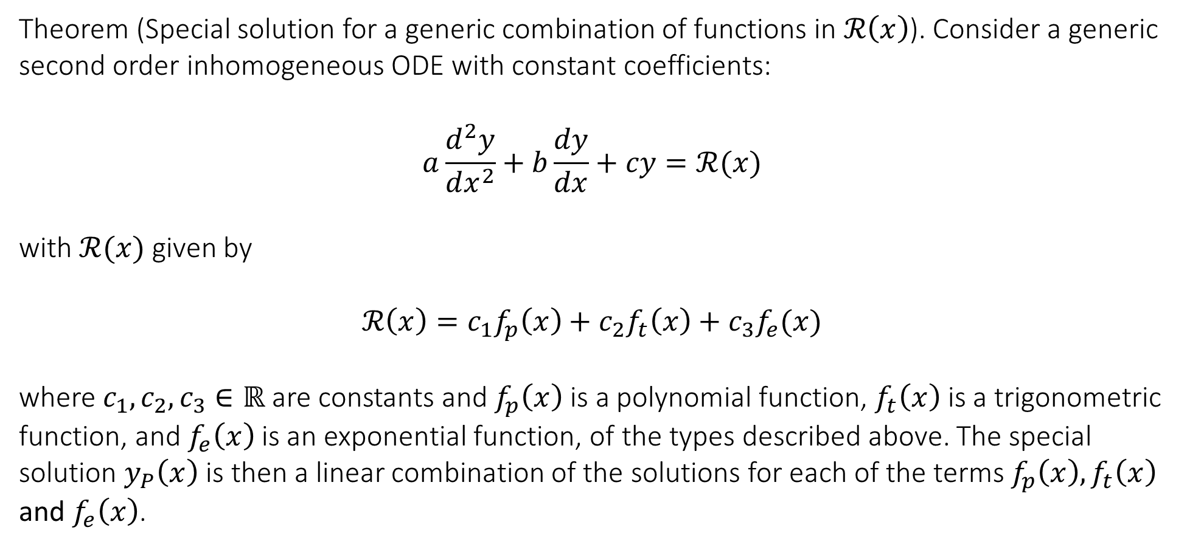
6.8 Finding a particular solution with the method of undetermined coefficients
Theorem (Special solution for a generic combination of functions in $ℛ\left(x\right)$). Consider a generic second order inhomogeneous ODE with constant coefficients:
$$a\frac{d^{2}y}{dx^{2}}+b\frac{dy}{dx}+cy=ℛ(x)$$
with $ℛ(x)$ given by
$$ℛ\left(x\right)=c_{1}f_{p}\left(x\right)+c_{2}f_{t}\left(x\right)+c_{3}f_{e}(x)$$
where $c_{1},c_{2},c_{3}∈ℝ$ are constants and $f_{p}\left(x\right)$ is a polynomial function, $f_{t}\left(x\right)$ is a trigonometric function, and $f_{e}\left(x\right)$ is an exponential function, of the types described above. The special solution $y_{P}\left(x\right)$ is then a linear combination of the solutions for each of the terms $f_{p}\left(x\right),f_{t}\left(x\right)$ and $f_{e}\left(x\right)$.

Slide 7
6.8 Finding a particular solution with the method of undetermined coefficients
Example. Find the general solution to the DE: $\frac{d^{2}y}{dx^{2}}+4\frac{dy}{dx}+6y=12x^{2}$

Slide 8
6.8 Finding a particular solution with the method of undetermined coefficients
Example. Find the general solution to the DE: $\frac{d^{2}y}{dx^{2}}−\frac{dy}{dx}−2y=\cos{x}$

Slide 9
6.8 Finding a particular solution with the method of undetermined coefficients
Example. Find the general solution to the DE: $\frac{d^{2}y}{dx^{2}}−2\frac{dy}{dx}−15y=32e^{−3x}$

Slide 10
6.8 Finding a particular solution with the method of undetermined coefficients
Example. Find the general solution to the DE: $\frac{d^{2}y}{dx^{2}}+4y=8\cos{2x}$

Slide 11
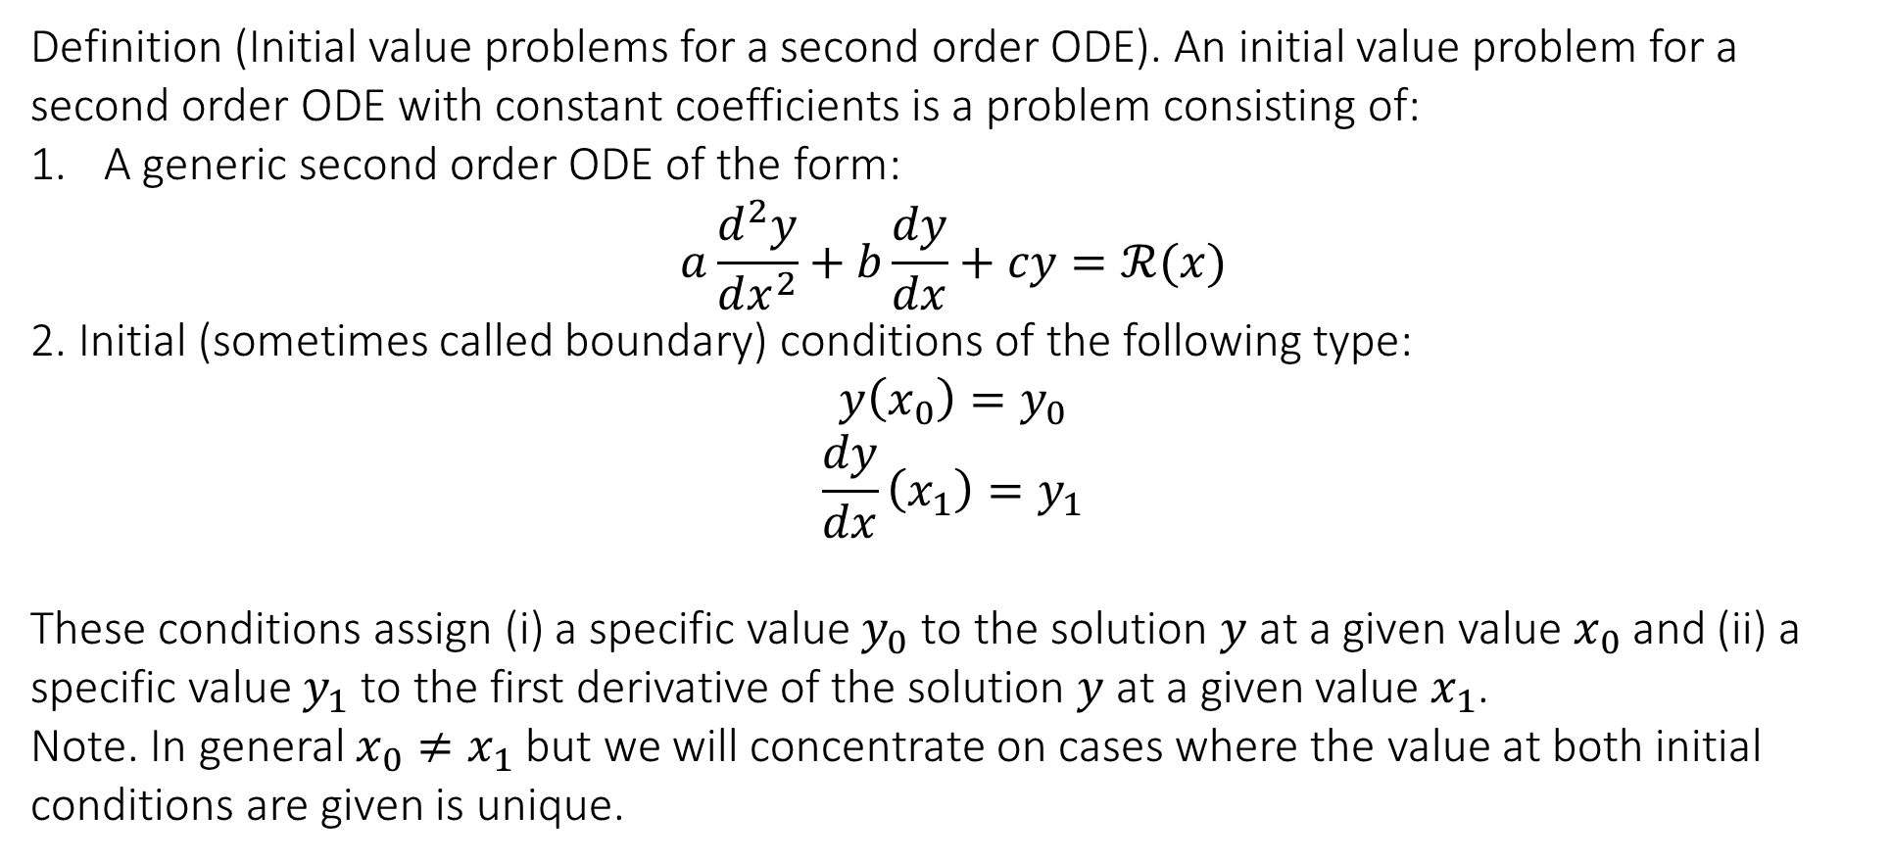
6.9 IVP for second order ODEs with constant coefficients
Definition (Initial value problems for a second order ODE). An initial value problem for a second order ODE with constant coefficients is a problem consisting of:
A generic second order ODE of the form:
$$a\frac{d^{2}y}{dx^{2}}+b\frac{dy}{dx}+cy=ℛ(x)$$
2. Initial (sometimes called boundary) conditions of the following type:
$$y\left(x_{0}\right)=y_{0}$$
$$\frac{dy}{dx}\left(x_{1}\right)=y_{1}$$
These conditions assign (i) a specific value $y_{0}$ to the solution $y$ at a given value $x_{0}$ and (ii) a specific value $y_{1}$ to the first derivative of the solution $y$ at a given value $x_{1}$.
Note. In general $x_{0}≠x_{1}$ but we will concentrate on cases where the value at both initial conditions are given is unique.

Slide 12

6.9 IVP for second order ODEs with constant coefficients
Example. Find the general solution of the following IVP
$$\left\{\begin{matrix}\frac{d^{2}y}{dx^{2}}+\frac{dy}{dx}−6y=12e^{3x} \\ y\left(0\right)=8 \\ y^{′}\left(0\right)=−2\end{matrix}\right.$$

Slide 13
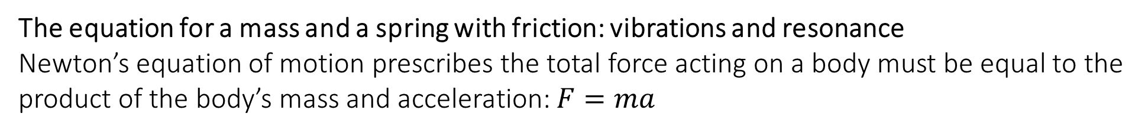

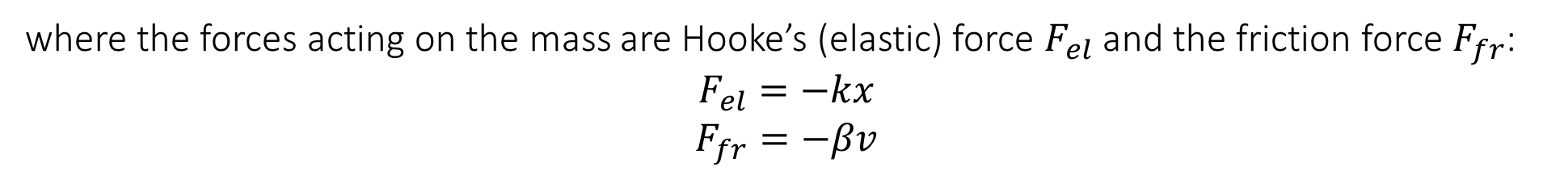
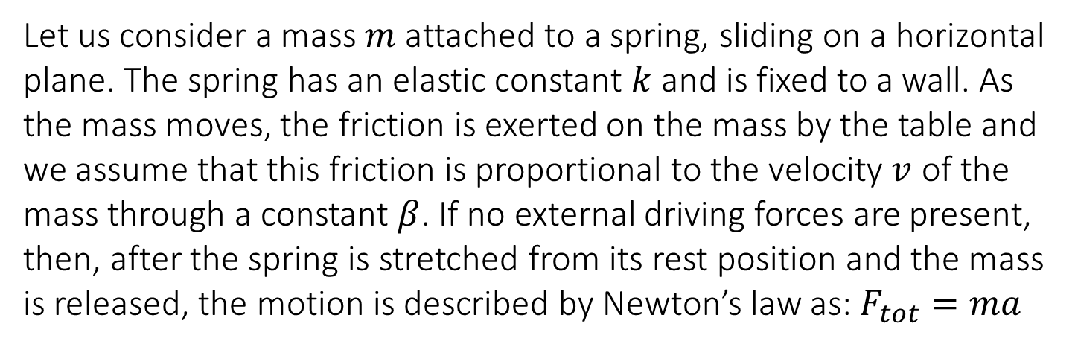
6.10 Applications of second order linear ODEs
The equation for a mass and a spring with friction: vibrations and resonance
Newton’s equation of motion prescribes the total force acting on a body must be equal to the product of the body’s mass and acceleration: $F=ma$
Let us consider a mass $m$ attached to a spring, sliding on a horizontal plane. The spring has an elastic constant $k$ and is fixed to a wall. As the mass moves, the friction is exerted on the mass by the table and we assume that this friction is proportional to the velocity $v$ of the mass through a constant $β$. If no external driving forces are present, then, after the spring is stretched from its rest position and the mass is released, the motion is described by Newton’s law as: $F_{tot}=ma$
where the forces acting on the mass are Hooke’s (elastic) force $F_{el}$ and the friction force $F_{fr}$:
$$F_{el}=−kx$$
$$F_{fr}=−βv$$
with both $k>0$ and $β>0$ by definition. The quantity $x$ represents the displacement of the spring from its equilibrium position (at rest).

Slide 14
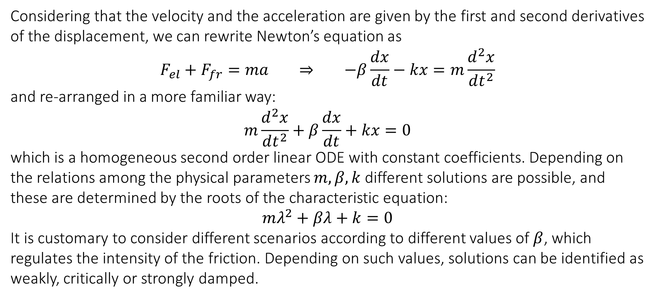
6.10 Applications of second order linear ODEs
Considering that the velocity and the acceleration are given by the first and second derivatives of the displacement, we can rewrite Newton’s equation as
$$F_{el}+F_{fr}=ma ⇒ −β\frac{dx}{dt}−kx=m\frac{d^{2}x}{dt^{2}}$$
and re-arranged in a more familiar way:
$$m\frac{d^{2}x}{dt^{2}}+β\frac{dx}{dt}+kx=0$$
which is a homogeneous second order linear ODE with constant coefficients. Depending on the relations among the physical parameters $m,β,k$ different solutions are possible, and these are determined by the roots of the characteristic equation:
$$mλ^{2}+βλ+k=0$$
It is customary to consider different scenarios according to different values of $β$, which regulates the intensity of the friction. Depending on such values, solutions can be identified as weakly, critically or strongly damped.

Slide 15
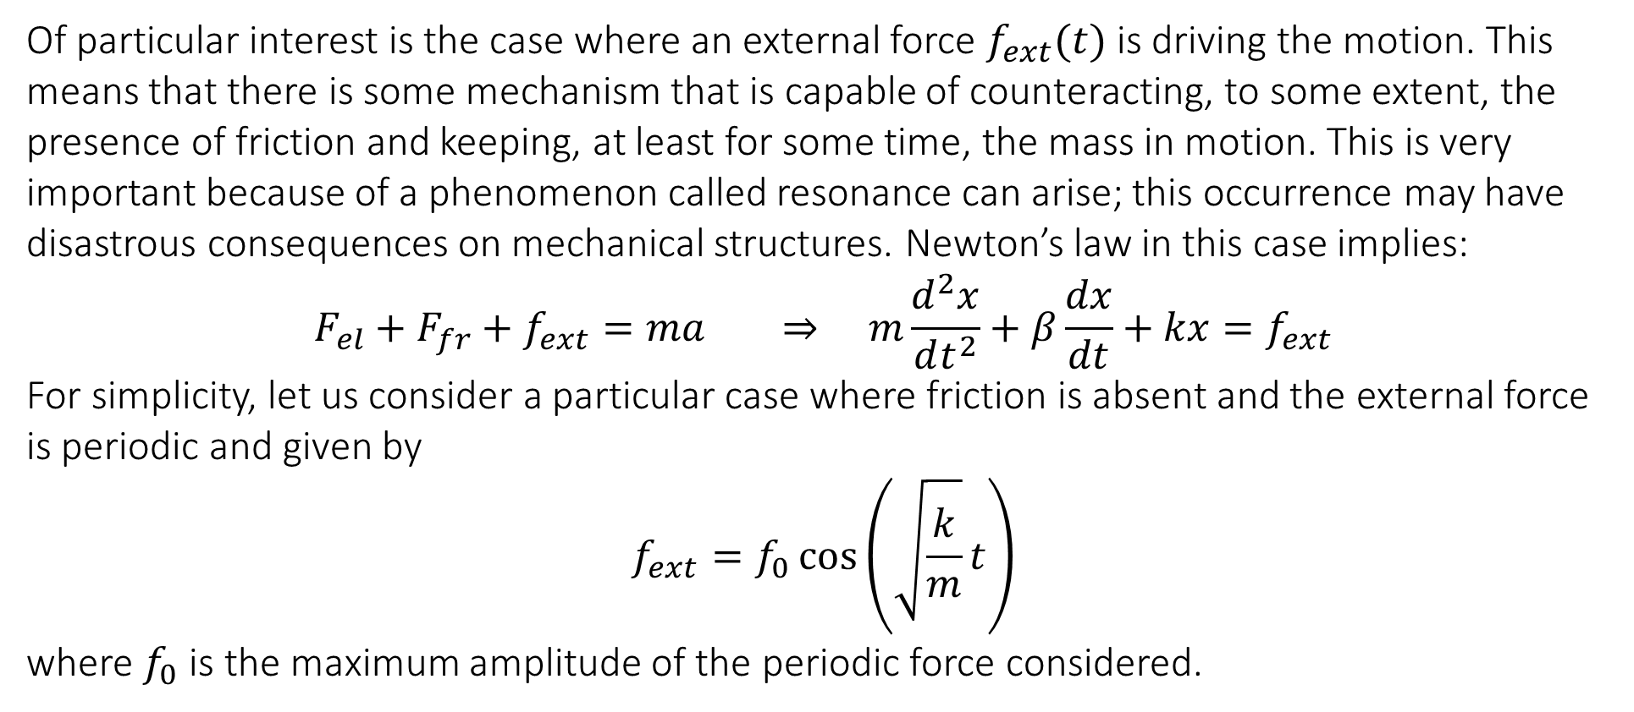
6.10 Applications of second order linear ODEs
Of particular interest is the case where an external force $f_{ext}(t)$ is driving the motion. This means that there is some mechanism that is capable of counteracting, to some extent, the presence of friction and keeping, at least for some time, the mass in motion. This is very important because of a phenomenon called resonance can arise; this occurrence may have disastrous consequences on mechanical structures. Newton’s law in this case implies:
$$F_{el}+F_{fr}+f_{ext}=ma ⇒ m\frac{d^{2}x}{dt^{2}}+β\frac{dx}{dt}+kx=f_{ext}$$
For simplicity, let us consider a particular case where friction is absent and the external force is periodic and given by
$$f_{ext}=f_{0}\cos\left(\sqrt{\frac{k}{m}}t\right)$$
where $f_{0}$ is the maximum amplitude of the periodic force considered.

Slide 16
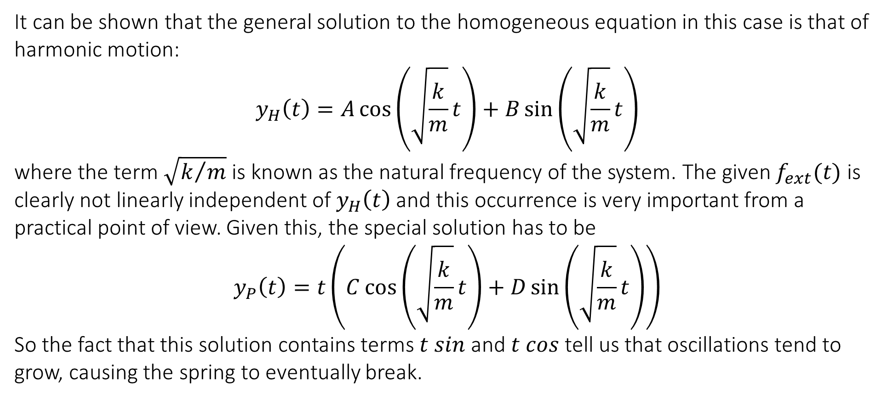
6.10 Applications of second order linear ODEs
It can be shown that the general solution to the homogeneous equation in this case is that of harmonic motion:
$$y_{H}\left(t\right)=A\cos\left(\sqrt{\frac{k}{m}}t\right)+B\sin\left(\sqrt{\frac{k}{m}}t\right)$$
where the term $\sqrt{k/m}$ is known as the natural frequency of the system. The given $f_{ext}(t)$ is clearly not linearly independent of $y_{H}\left(t\right)$ and this occurrence is very important from a practical point of view. Given this, the special solution has to be
$$y_{P}\left(t\right)=t\left(C\cos\left(\sqrt{\frac{k}{m}}t\right)+D\sin\left(\sqrt{\frac{k}{m}}t\right)\right)$$
So the fact that this solution contains terms $t sin$ and $t cos$ tell us that oscillations tend to grow, causing the spring to eventually break.

Slide 17
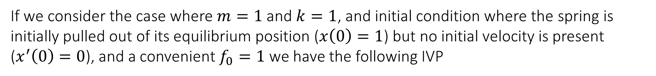

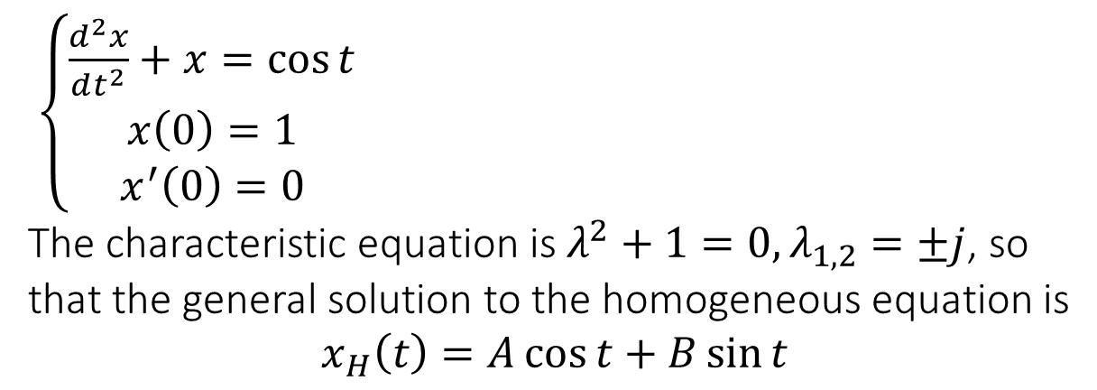
6.10 Applications of second order linear ODEs
If we consider the case where $m=1$ and $k=1$, and initial condition where the spring is initially pulled out of its equilibrium position ($x\left(0\right)=1$) but no initial velocity is present ($x^{′}\left(0\right)=0$), and a convenient $f_{0}=1$ we have the following IVP
$\left\{\begin{matrix}\frac{d^{2}x}{dt^{2}}+x=\cos{t} \\ x\left(0\right)=1 \\ x^{′}\left(0\right)=0\end{matrix}\right.$
The characteristic equation is $λ^{2}+1=0, λ_{1,2}=±j$, so that the general solution to the homogeneous equation is
$$x_{H}\left(t\right)=A\cos{t}+B\sin{t}$$
The particular solution has to be found by adjusting parameters for the trial solution
$$x_{P}\left(t\right)=t(C\cos{t}+D\sin{t})$$
With final solution:
$$x\left(t\right)=\cos{t}+\frac{1}{2}t\sin{t}$$

Slide 18
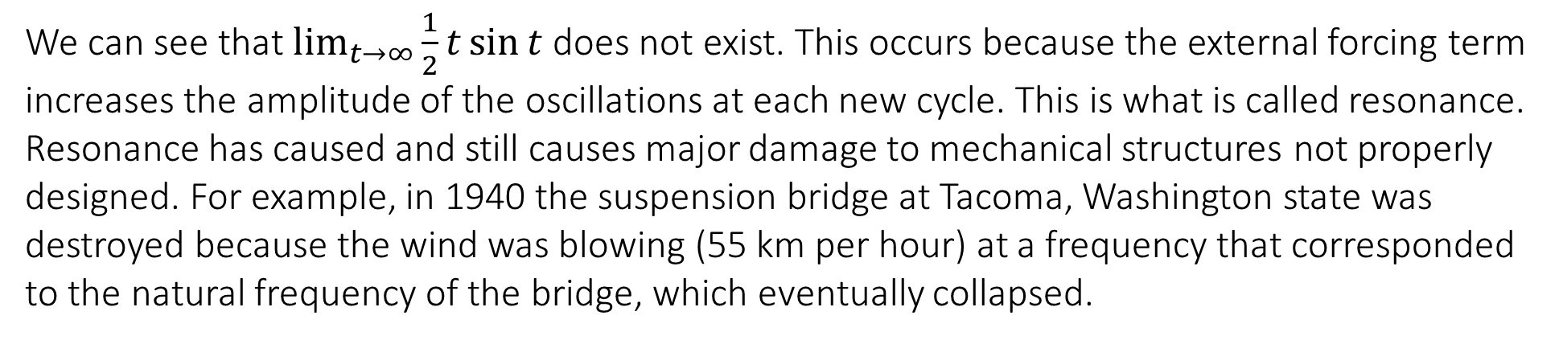
6.10 Applications of second order linear ODEs
We can see that $\lim_{t→∞}{\frac{1}{2}t\sin{t}}$ does not exist. This occurs because the external forcing term increases the amplitude of the oscillations at each new cycle. This is what is called resonance. Resonance has caused and still causes major damage to mechanical structures not properly designed. For example, in 1940 the suspension bridge at Tacoma, Washington state was destroyed because the wind was blowing (55 km per hour) at a frequency that corresponded to the natural frequency of the bridge, which eventually collapsed.

Slide 19
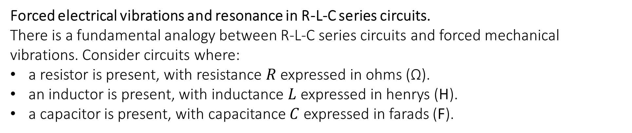
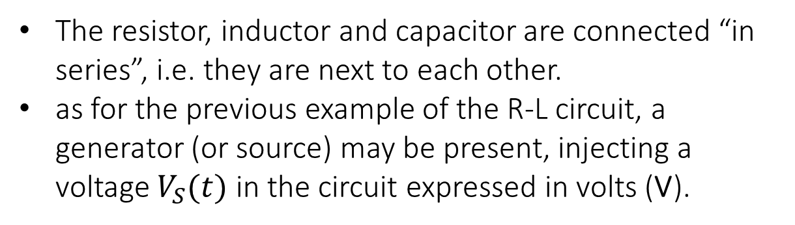
6.10 Applications of second order linear ODEs
Forced electrical vibrations and resonance in R-L-C series circuits.
There is a fundamental analogy between R-L-C series circuits and forced mechanical vibrations. Consider circuits where:
a resistor is present, with resistance $R$ expressed in ohms (Ω).
an inductor is present, with inductance $L$ expressed in henrys (H).
a capacitor is present, with capacitance $C$ expressed in farads (F).
The resistor, inductor and capacitor are connected “in series”, i.e. they are next to each other.
as for the previous example of the R-L circuit, a generator (or source) may be present, injecting a voltage $V_{S}(t)$ in the circuit expressed in volts (V).

Slide 20
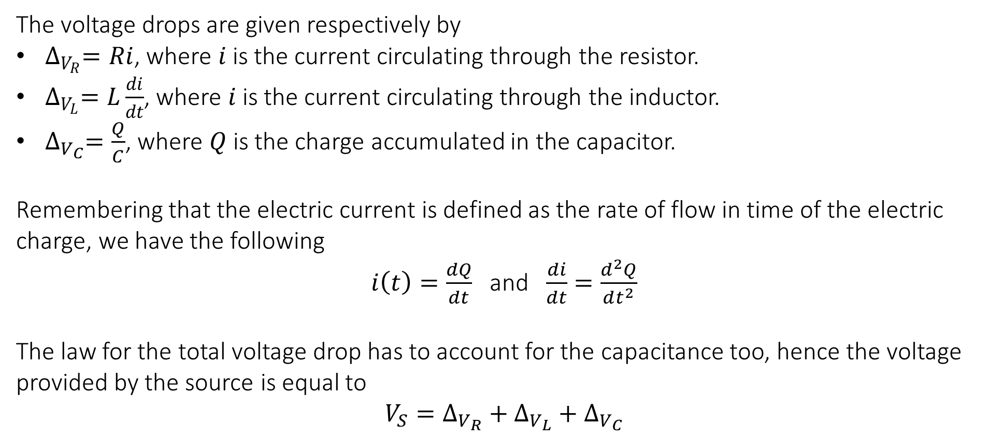
6.10 Applications of second order linear ODEs
The voltage drops are given respectively by
$∆_{V_{R}}=Ri$, where $i$ is the current circulating through the resistor.
$∆_{V_{L}}=L\frac{di}{dt}$, where $i$ is the current circulating through the inductor.
$∆_{V_{C}}=\frac{Q}{C}$, where $Q$ is the charge accumulated in the capacitor.
Remembering that the electric current is defined as the rate of flow in time of the electric charge, we have the following
$i\left(t\right)=\frac{dQ}{dt}$ and $\frac{di}{dt}=\frac{d^{2}Q}{dt^{2}}$
The law for the total voltage drop has to account for the capacitance too, hence the voltage provided by the source is equal to
$$V_{S}=∆_{V_{R}}+∆_{V_{L}}+∆_{V_{C}}$$

Slide 21
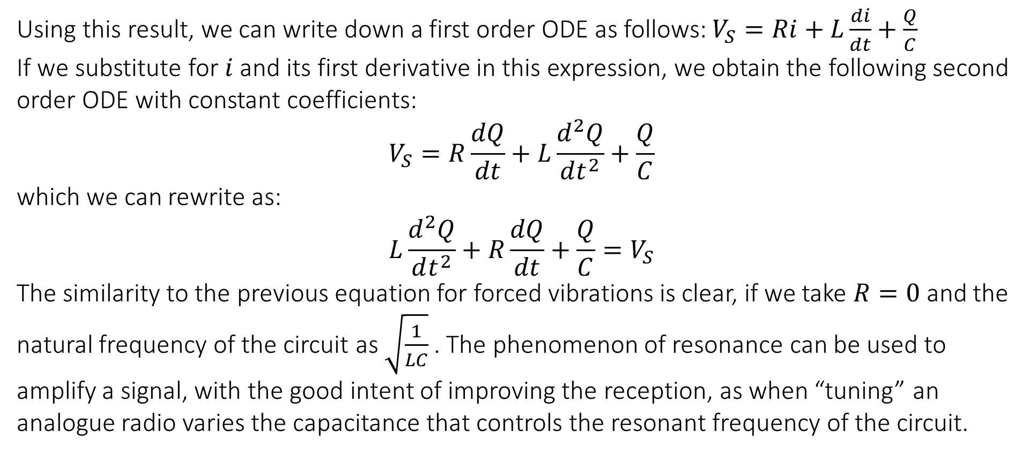
6.10 Applications of second order linear ODEs
Using this result, we can write down a first order ODE as follows: $V_{S}=Ri+L\frac{di}{dt}+\frac{Q}{C}$
If we substitute for $i$ and its first derivative in this expression, we obtain the following second order ODE with constant coefficients:
$$V_{S}=R\frac{dQ}{dt}+L\frac{d^{2}Q}{dt^{2}}+\frac{Q}{C}$$
which we can rewrite as:
$$L\frac{d^{2}Q}{dt^{2}}+R\frac{dQ}{dt}+\frac{Q}{C}=V_{S}$$
The similarity to the previous equation for forced vibrations is clear, if we take $R=0$ and the natural frequency of the circuit as $\sqrt{\frac{1}{LC}}$ . The phenomenon of resonance can be used to amplify a signal, with the good intent of improving the reception, as when “tuning” an analogue radio varies the capacitance that controls the resonant frequency of the circuit.

Slide 22
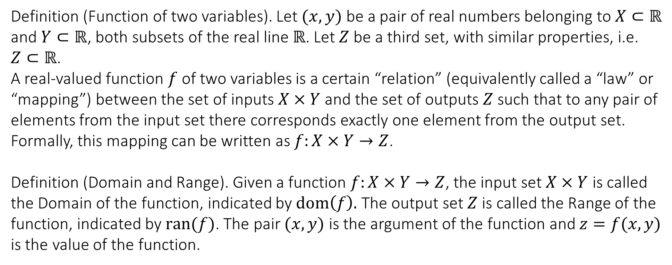
7.1 Surfaces as functions of two variables
MODULE 7
Definition (Function of two variables). Let $(x,y)$ be a pair of real numbers belonging to $X⊂ℝ$ and $Y⊂ℝ$, both subsets of the real line $ℝ$. Let $Z$ be a third set, with similar properties, i.e. $Z⊂ℝ$.
A real-valued function $f$ of two variables is a certain “relation” (equivalently called a “law” or “mapping”) between the set of inputs $X×Y$ and the set of outputs $Z$ such that to any pair of elements from the input set there corresponds exactly one element from the output set. Formally, this mapping can be written as $f:X×Y→Z$.
Definition (Domain and Range). Given a function $f:X×Y→Z$, the input set $X×Y$ is called the Domain of the function, indicated by $dom\left(f\right).$ The output set $Z$is called the Range of the function, indicated by $ran(f)$. The pair $(x,y)$ is the argument of the function and $z=f(x,y)$ is the value of the function.

Slide 23
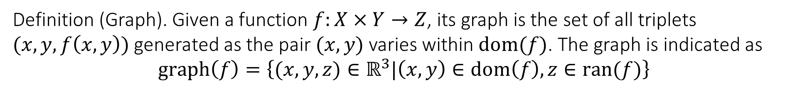
7.1 Surfaces as functions of two variables
Definition (Graph). Given a function $f:X×Y→Z$, its graph is the set of all triplets $(x,y,f\left(x,y\right))$ generated as the pair $(x,y)$ varies within $dom(f)$. The graph is indicated as
$$graph\left(f\right)=\left\{(x,y,z)∈ℝ^{3}|\left(x,y\right)∈dom\left(f\right),z∈ran(f)\right\}$$

Slide 24
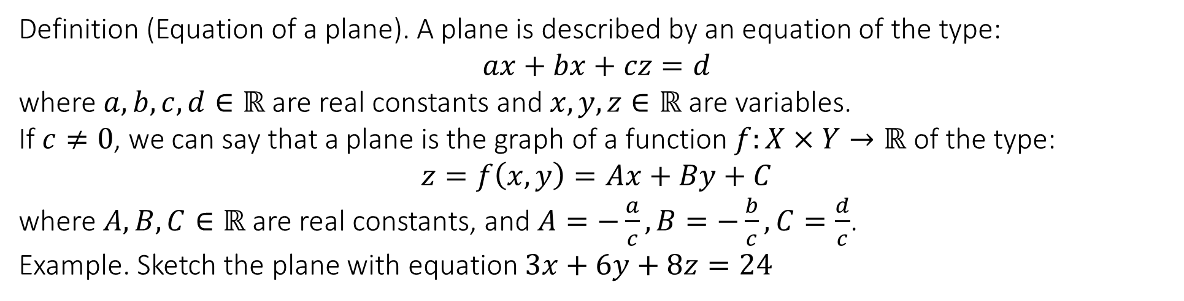
7.1 Surfaces as functions of two variables
Definition (Equation of a plane). A plane is described by an equation of the type:
$$ax+bx+cz=d$$
where $a,b,c,d∈ℝ$ are real constants and $x,y,z∈ℝ$ are variables.
If $c≠0$, we can say that a plane is the graph of a function $f:X×Y→ℝ$ of the type:
$$z=f\left(x,y\right)=Ax+By+C$$
where $A,B,C∈ℝ$ are real constants, and $A=−\frac{a}{c}, B=−\frac{b}{c}, C=\frac{d}{c}$.
Example. Sketch the plane with equation $3x+6y+8z=24$

Slide 25
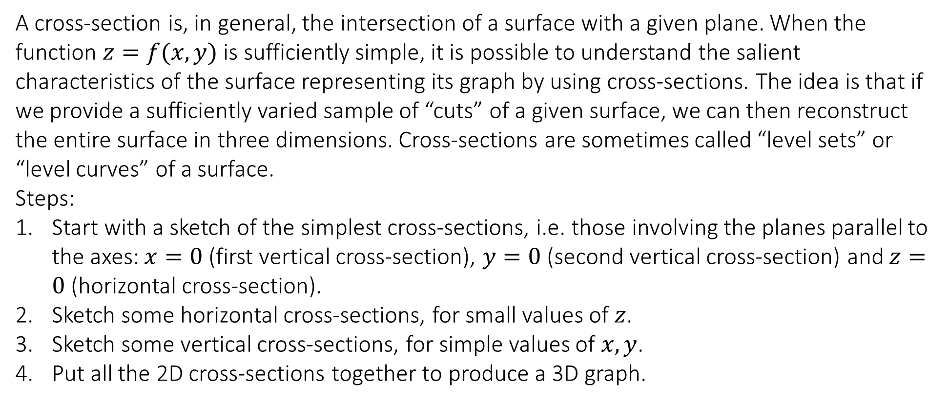
7.2 The method of cross-sections and simple surfaces
A cross-section is, in general, the intersection of a surface with a given plane. When the function $z=f(x,y)$ is sufficiently simple, it is possible to understand the salient characteristics of the surface representing its graph by using cross-sections. The idea is that if we provide a sufficiently varied sample of “cuts” of a given surface, we can then reconstruct the entire surface in three dimensions. Cross-sections are sometimes called “level sets” or “level curves” of a surface.
Steps:
Start with a sketch of the simplest cross-sections, i.e. those involving the planes parallel to the axes: $x=0$ (first vertical cross-section), $y=0$ (second vertical cross-section) and $z=0$ (horizontal cross-section).
Sketch some horizontal cross-sections, for small values of $z$.
Sketch some vertical cross-sections, for simple values of $x,y$.
Put all the 2D cross-sections together to produce a 3D graph.

Slide 26
7.2 The method of cross-sections and simple surfaces
Example. Sketch the surface defined by $z=x^{2}+y^{2}$

Slide 27
7.2 The method of cross-sections and simple surfaces
Example. Sketch the surface defined by $z=x^{2}+{6y}^{2}$

Slide 28
7.2 The method of cross-sections and simple surfaces
Example. Sketch the surface defined by $z=\sqrt{25x^{2}+16y^{2}}$

Slide 29

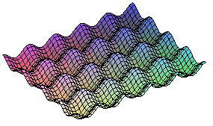
7.2 The method of cross-sections and simple surfaces
$$z=\sin{x}+\sin{y}$$

Slide 30
End of Lecture

